Slide 1

Operator SDK & OLM
OPERATOR
FRAMEWORK
Support continuous iterative development and testing
Oren Oichman
Red Hat Cloud Senior consultant

Slide 2
State of the Operator Framework
OPTIONAL SECTION MARKER OR TITLE

Slide 3






ORIGINAL OPERATOR FRAMEWORK ECOSYSTEM
Build
Run
Operate

Slide 4
OPERATOR FRAMEWORK ECOSYSTEM TODAY
Build
Run
Operate
OPERATOR
SCORECARD
OPERATOR
HUB
OPERATOR
COURIER
OPERATOR
REGISTRY
Test
Marketplace
Publish / verify
Package /
Catalog

Slide 5

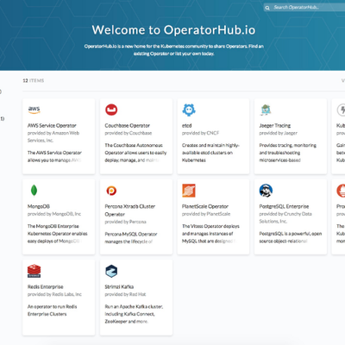
OPERATOR FRAMEWORK ECOSYSTEM TODAY
OPERATOR
HUB.IO
CONTAINER
VERIFICATION
Community
Verification Pipeline
Build
Run
Operate
OPERATOR
SCORECARD
OPERATOR
HUB
OPERATOR
COURIER
OPERATOR
REGISTRY
Test
Marketplace
Publish / verify
Package /
Catalog

Slide 6
Operator SDK Themes
OPTIONAL SECTION MARKER OR TITLE

Slide 7
We need to make it easy to continuously develop and test Operators
1

Slide 8
We need to significantly decrease the product surface in that process
2

Slide 9
We need to be as close to upstream Kubernetes as possible
3

Slide 10
Targeted UX
OPTIONAL SECTION MARKER OR TITLE

Slide 11




OPERATOR LIFECYCLE STAGES
Operator Developer
Test
Push
Scaffold
Develop
Package / Verify
Run
SDK
OLM
Operator Developer
Code + Manifests
Bundle
Registry

Slide 12
OPERATOR LIFECYCLE STAGES
Operator Developer
Test
Push
Scaffold
Develop
Package / Verify
Run
SDK
OLM
Operator Developer
Code + Manifests
Bundle
Registry

Slide 13
What this means for OLM
OPTIONAL SECTION MARKER OR TITLE

Slide 14
OLM v2
First-class object for installed Operators (kubectl get operators)
Purpose-built, searchable registry of Operators (based on container registry)
Reducing API surface dramatically, especially to run a single Operator
Upstream-compatible bundle format ([plain k8s|CNAB] + OCI, helm or similar)
MAKE IT EASY TO DEVELOP OPERATORS

Slide 15
What this means for the SDK

Slide 16
Make it easy

Slide 17
This includes:
Continue to have first-class dev UX
Support more languages (Python, Java, ...)
Provide automatism for migrations through SDK updates
Provide automatism for updates from source DSLs (helm, Ansible)
MAKE IT EASY TO DEVELOP OPERATORS

Slide 18
Continuously Develop and Test

Slide 19
This includes:
Create a bundle of plain Kubernetes manifests (enabled by OLM bundle spec)
Running a bundled Operator directly against a cluster (enabled by OLM)
Shipping functional tests with the Operator (part of the OLM bundle spec)
Being CI-friendly
(Providing a quick way of kickstarting an OLM deployment on a supplied cluster)
MAKE IT EASY TO TEST AND DEVELOP OPERATORS WITH QUICK FEEDBACK LOOPS

Slide 20
Close to upstream as possible
OPTIONAL SECTION MARKER OR TITLE

Slide 21
This includes:
Adopt Kubebuilder layout for Golang-based Operators
Enable all other languages / Operator types as Kubebuilder plugins
Ship Operator-SDK as a shim with Kubebuilder + OLM-specific features
Publish the Operator in a upstream-accepted format
AS UPSTREAM-FRIENDLY AS POSSIBLE

Slide 22

Exercise 4
Oren Oichman - custom K8S automations with Operators

Slide 23

Thank you
Red Hat is the world’s leading provider of enterprise open source software solutions. Award-winning support, training, and consulting services make
Red Hat a trusted adviser to the Fortune 500.

